Slide 1
Lesson 7 - Intro to Objects/Maps
Mr Mack 2019

Slide 2
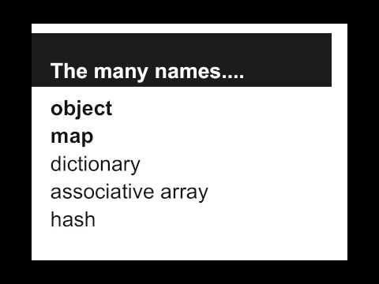
Intro to Objects/Maps

Slide 3
Suppose we’ve created an object phonebook that contains our friends’ names (keys) associated with their phone numbers (values). How can we get the phone number for Jenny?
var number = phonebook["Jenny"];
var number = phonebook{"Jenny"};
var number = phonebook.indexOf("Jenny");
var number = phonebook.number("Jenny");

Slide 4
How can we set the number for Jenny in phonebook to be "867-5309"?
phonebook["Jenny"] = "867-5309";
phonebook["867-5309"] = "Jenny";
phonebook.setJenny("867-5309");
phonebook["867-5309", "Jenny"];

Slide 5
What is an Object/Map?
An ordered list of objects
An unordered list of objects
A collection of (key, value) pairs
A function

Slide 6
Example: Phonebook
This is an example for this lesson. You are encouraged to play around with it, run and change the code, and learn how it works. When you are done, click continue to go to the next problem.

Slide 7
Exercise 5.7.1: Sidekicks
Police Commissioner Gordon has tasked you with building up a database of superhero sidekicks, just in case the superheros are all busy.
Given a superhero name, we need to be able to look up the name of that superhero’s sidekick. We’ve already started the database for you, but you need to add to it.
Add an entry to the sidekicks Object for Batman’s sidekick Robin.
Get the name of Mermaid Man’s sidekick and print it out
Who is your sidekick? Add their name to the sidekicks Object as your sidekick

